Slide 1
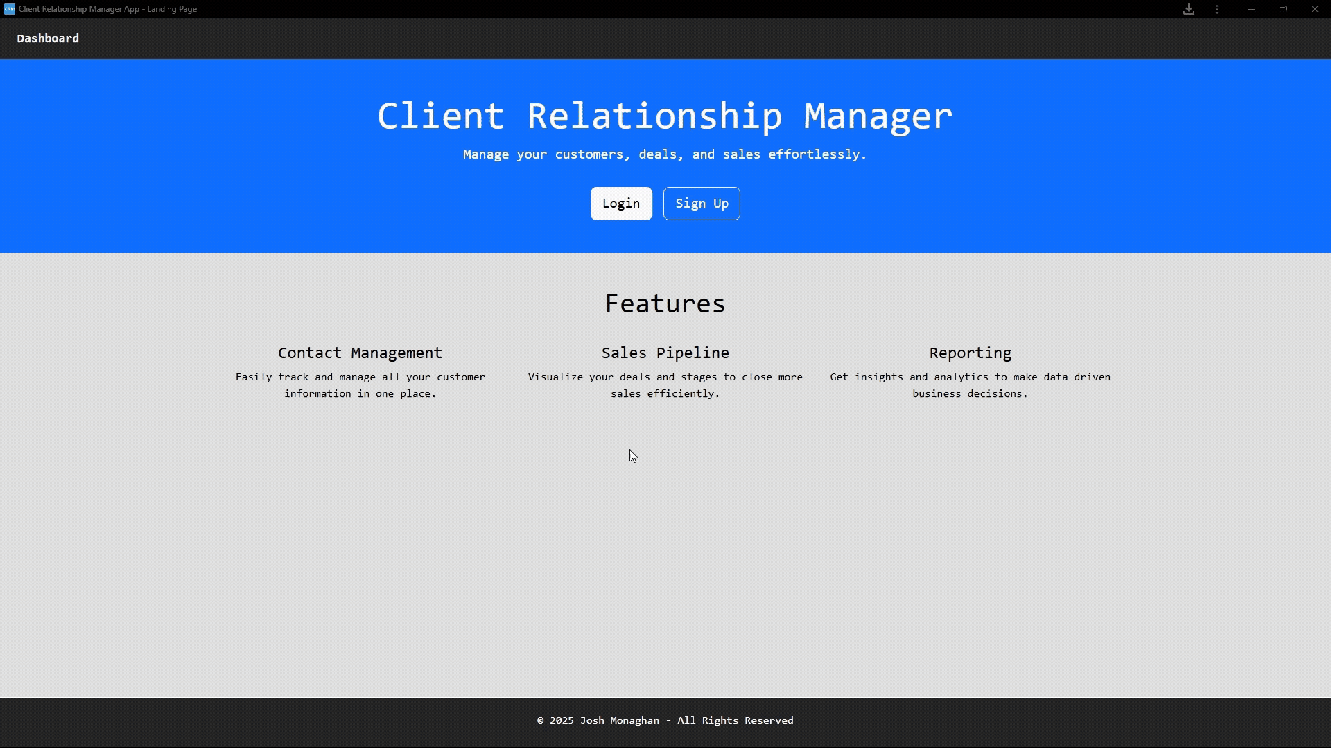
Client Relationship Manager
Software Engineering Major Project

Slide 2
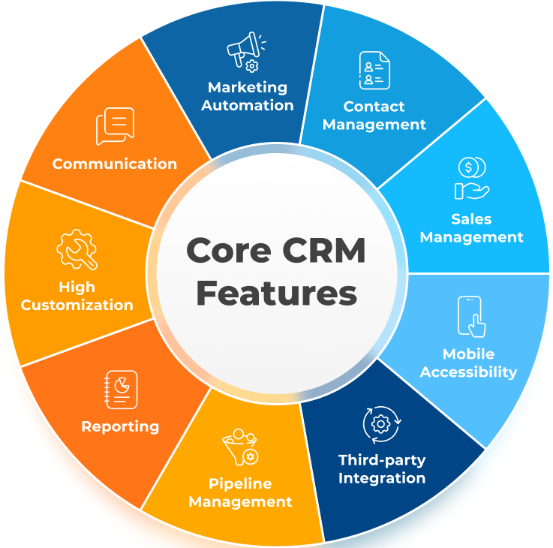
What is a CRM?
Notes:
What is a CRM
Customer Relationship Management
Helps businesses manage interactions
Track Companies: Invoice, Quotes, Leads

Slide 3
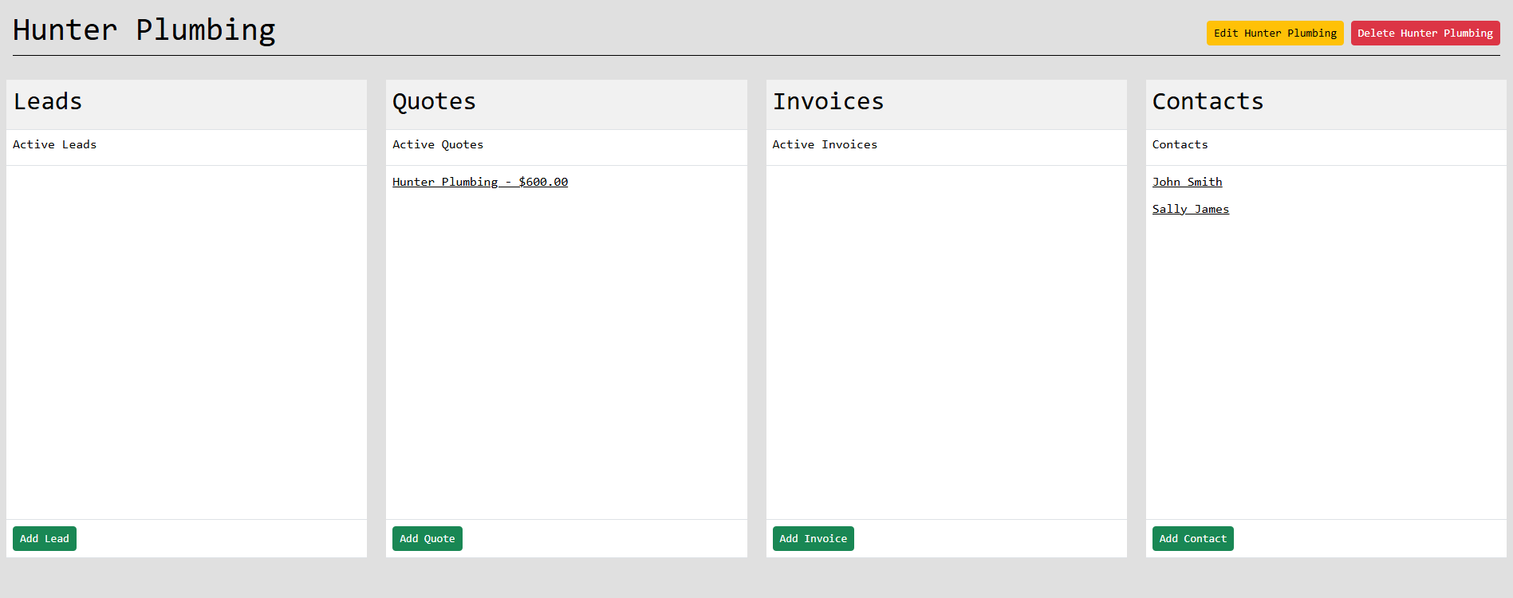
What’s the need for a CRM?
Notes:
What’s the need for a CRM?
Allows business to track their quote, leads, invoices
Organises the businesses interactions
Keeps a record of all companies, contacts and existing leads, quotes and invoices

Slide 4
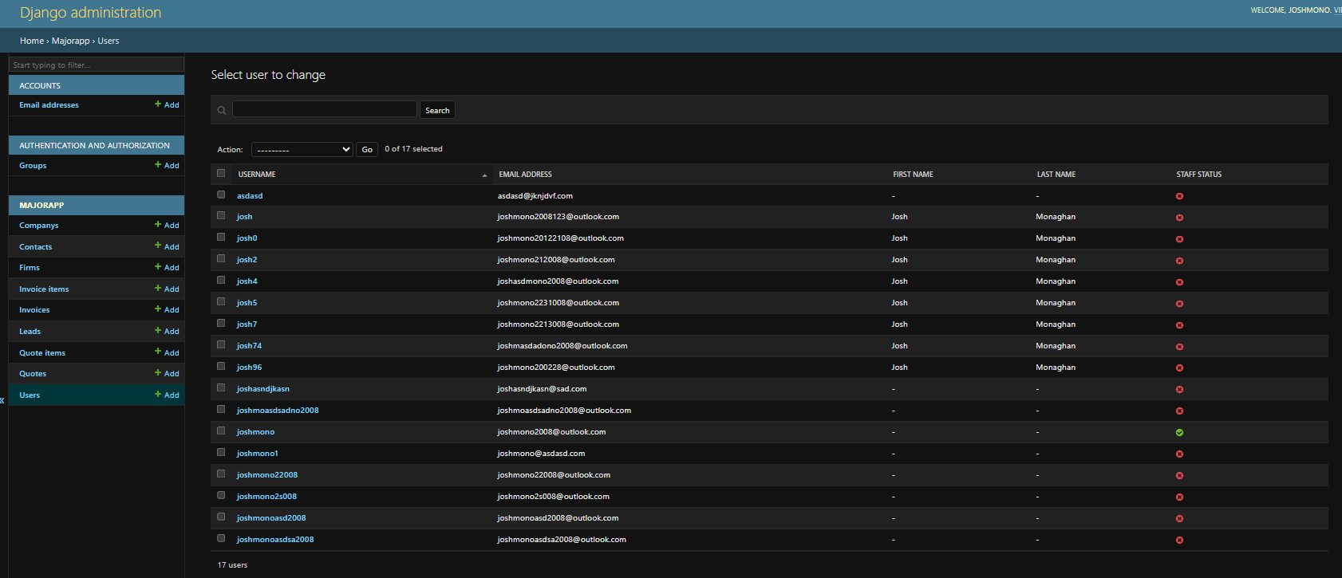
Legal Implications
Notes:
Legal Implications
Storing contact, lead, and company information means the app must follow privacy laws like the Australian Privacy Act or GDPR
Security Measures: When storing sensitive data, it's important to use protection techniques like, access controls, authentication and secure hosting
All data is being stored on the CRM databases which is data ownership issue, this means if I misuses data or share data without permission legal applications could occur
Invoices and quotes may be considered legal documents, so they must be accurate and securely stored.
Any external tools like Bootstrap or WeasyPrint must be used under proper open-source licenses.

Slide 5
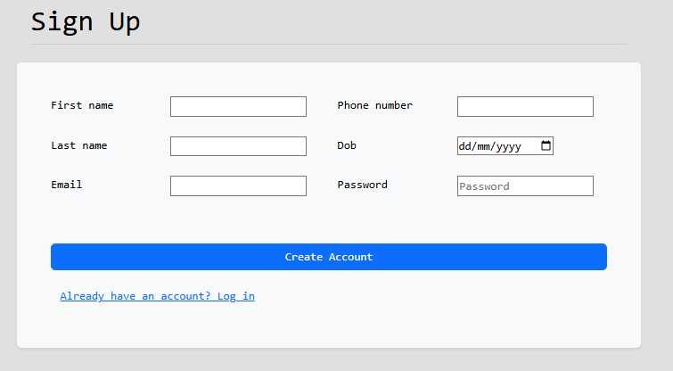
Ethical Implications
Notes:
Ethical Implications
It’s important to only collect what’s necessary and avoid storing sensitive info without consent
Ethically, the app should help users keep customer and lead information accurate and up to date
I have a duty to protect user data through secure coding practices and access controls.
The CRM should not be used to spam, mislead, or pressure leads and clients
App is usable by everyone, including people with disabilities.

Slide 6

Social Implications
Notes:
Social Implications
The CRM helps teams communicate better by keeping all client/companies' info in one place, reducing misunderstandings
CRMs can Impact Jobs which may reduce manual admin tasks but can also require staff to adapt to new technology.
Businesses without access to tools like this CRM may fall behind in the industry which leads me to technology gaps in small or rural businesses.
The CRM has offline support to help rural businesses who might have limited internet.

Slide 7
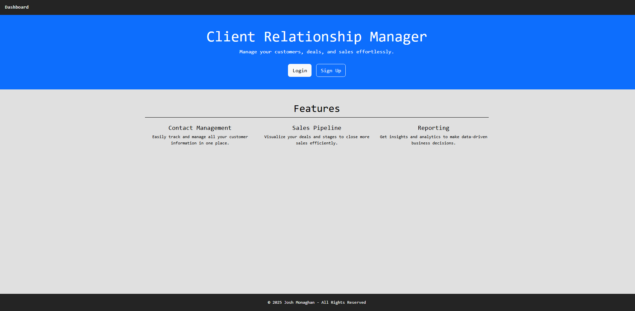
Requirements and Expectations for the project
Notes:
Requirements for the project:
The main requirements the client wanted was for the project to do be able to add, create, edit and delete the following things:
Companies
Contacts
Leads
Quotes
Invoices
While also wanting the option to generate PDF reports on quotes and invoices
The software also had to be secure because of sensitive data being stored.

Slide 8
Non-Functional Requirements
Notes:
Non-Functional Requirements for the project:
All pages must load in 3 seconds on an average internet speed
All pages must have links to navigate to another page
Users must only see their own data
Reports must not take longer then 5 seconds to generate

Slide 9
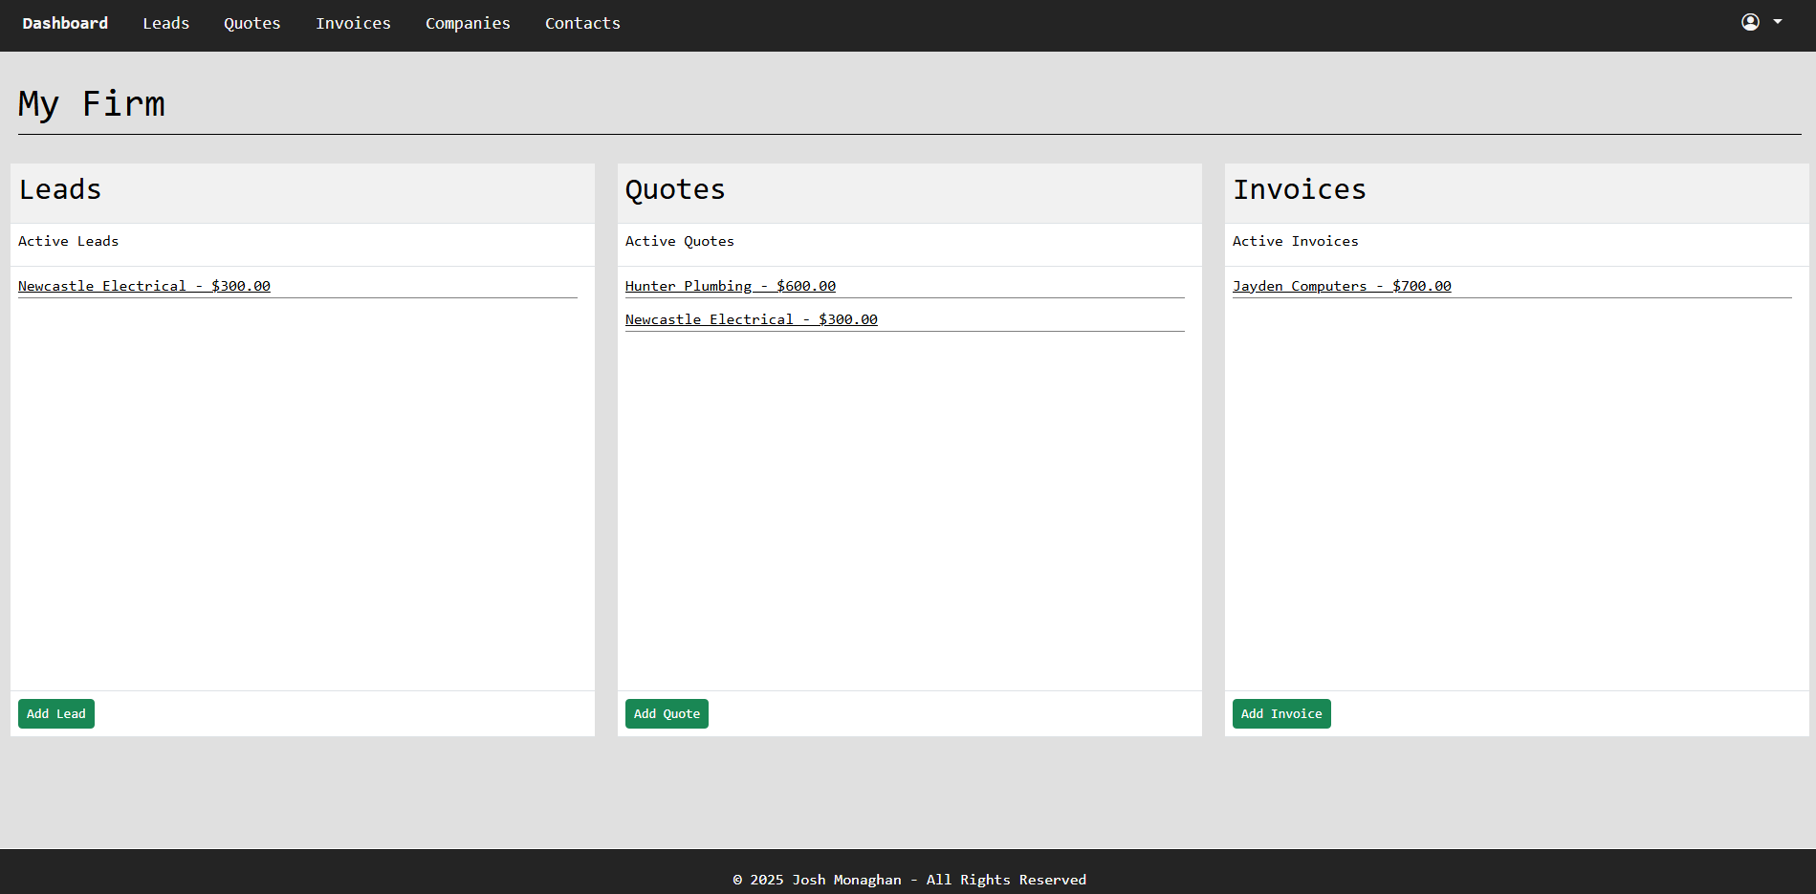
What are features of my CRM?
Notes:
What are features of my CRM?
Features:
User Login and Signup
Leads
Quotes
Invoices
Companies
Contacts
Reporting

Slide 10
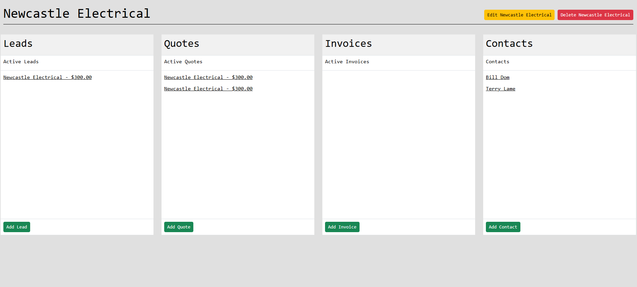
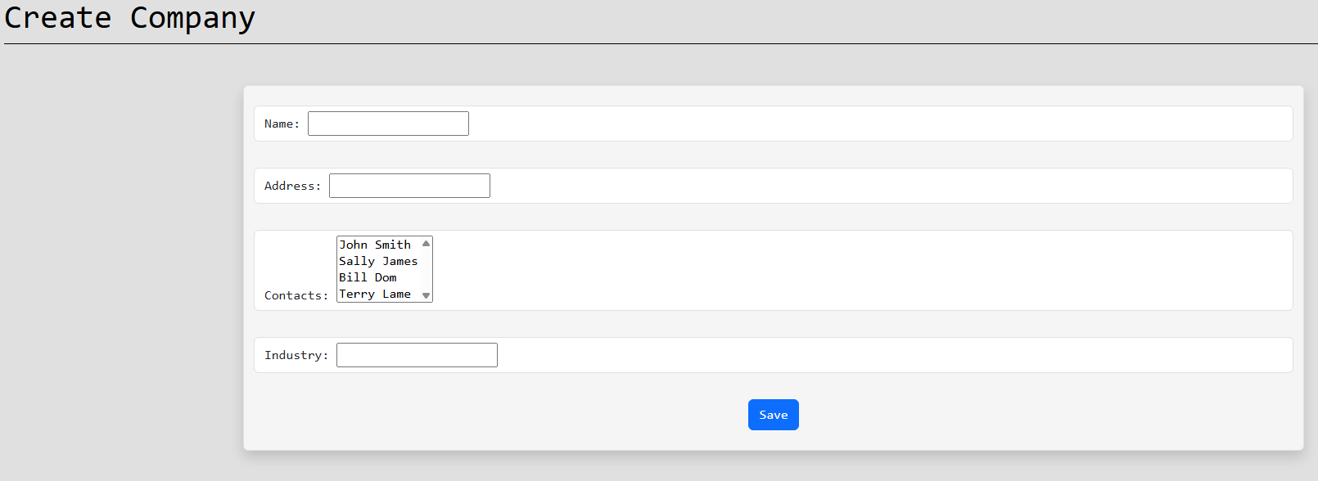
Companies
Notes:
Companies
Everything connects back to Companies
Company stores key info like name, contact details, industry, and notes
Leads and quotes are linked to companies using Django foreign keys
This makes it easy to view all leads, quotes, and interactions for a specific company
Strong company structure makes the app more organised and scalable

Slide 11
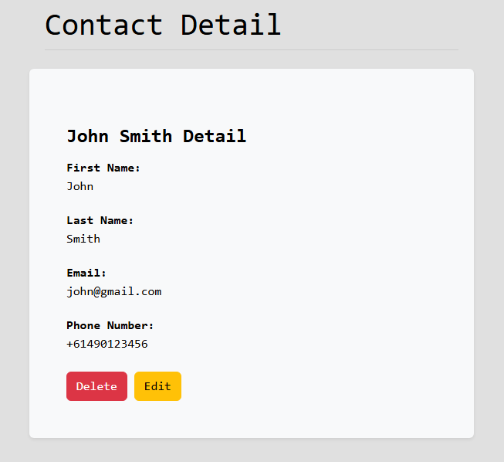
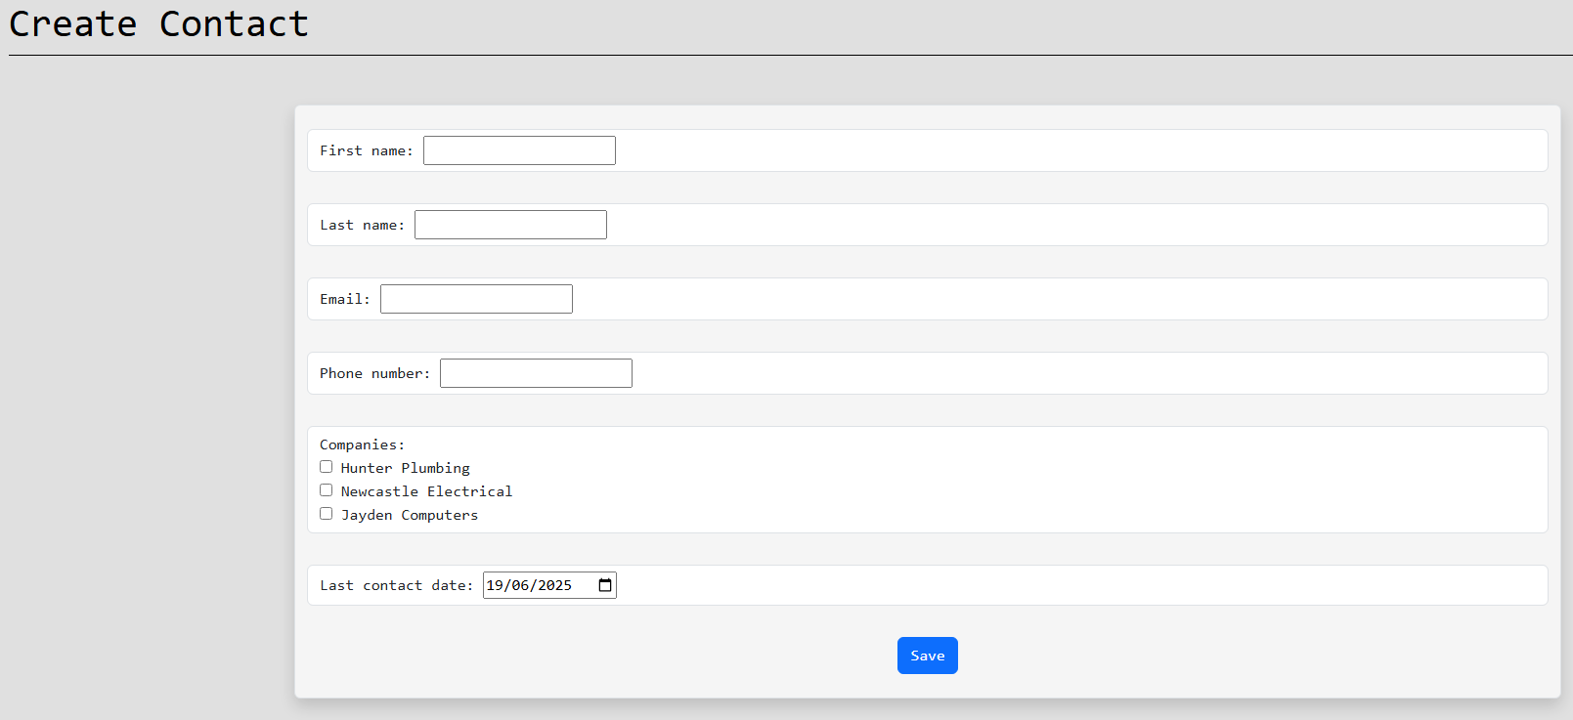
Contacts
Notes:
Contacts
Contacts represent individual people
Contacts can be linked to many companies
Each contact stores details like name, phone number and email
They can be assigned to leads, quotes or invoices to show who the point of contact is
Allows to keep track and reference individuals to companies

Slide 12
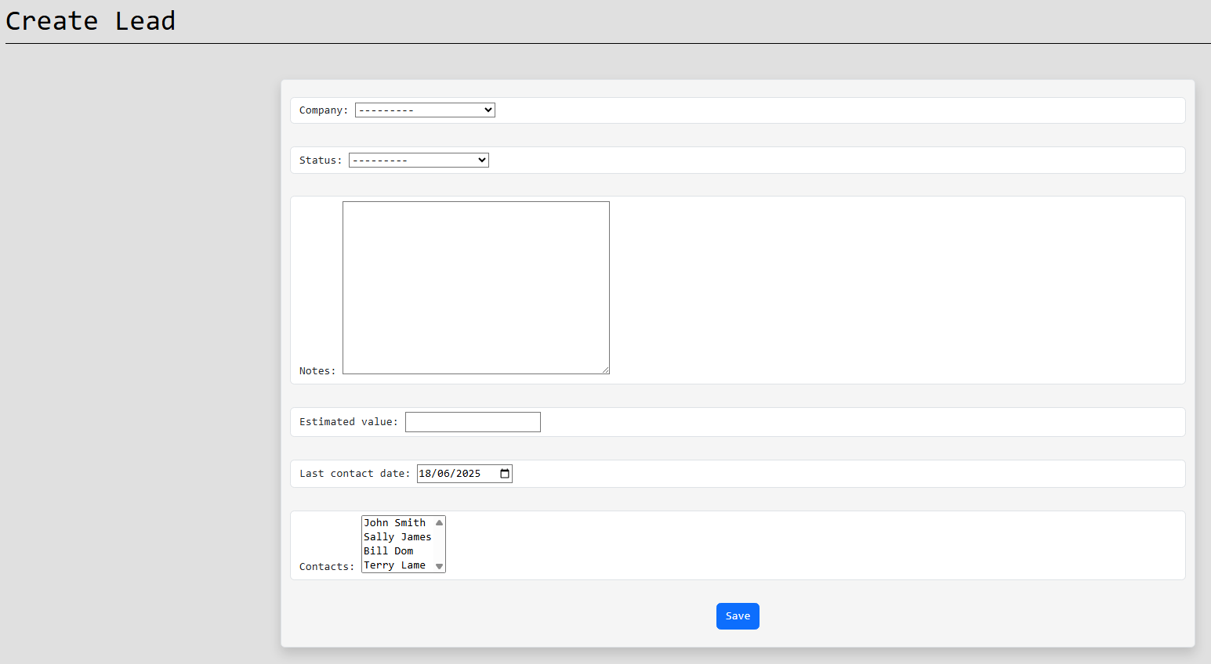
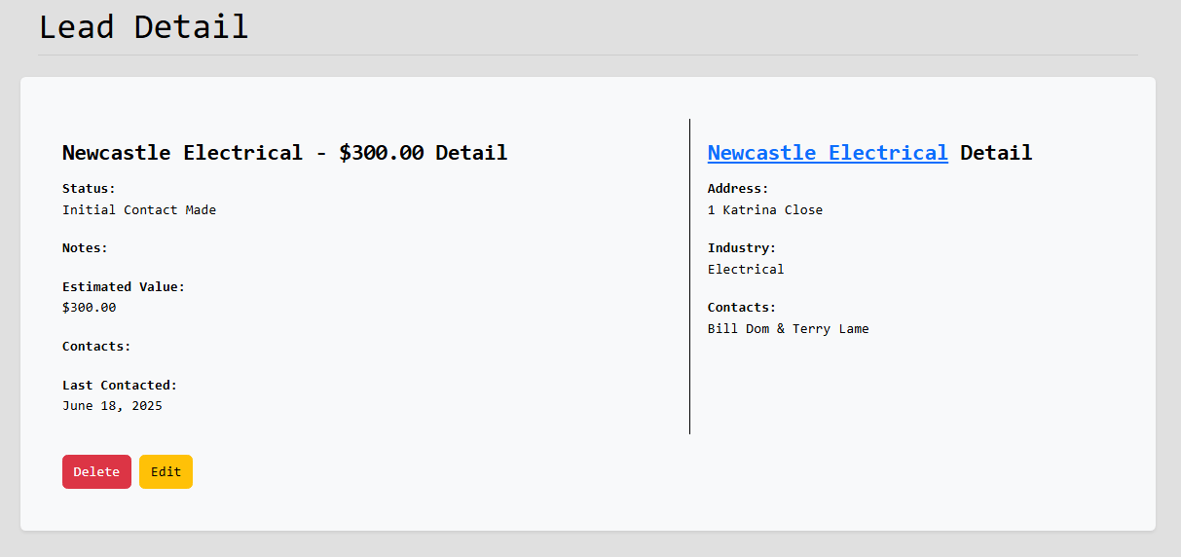
Leads
Notes:
Leads
They represent potential customers or clients who have shown interest but haven’t been converted yet
Lead in the system stores information such as their company, contact details, lead status, estimated price, last contacted and notes
Goal was to make lead tracking simple

Slide 13
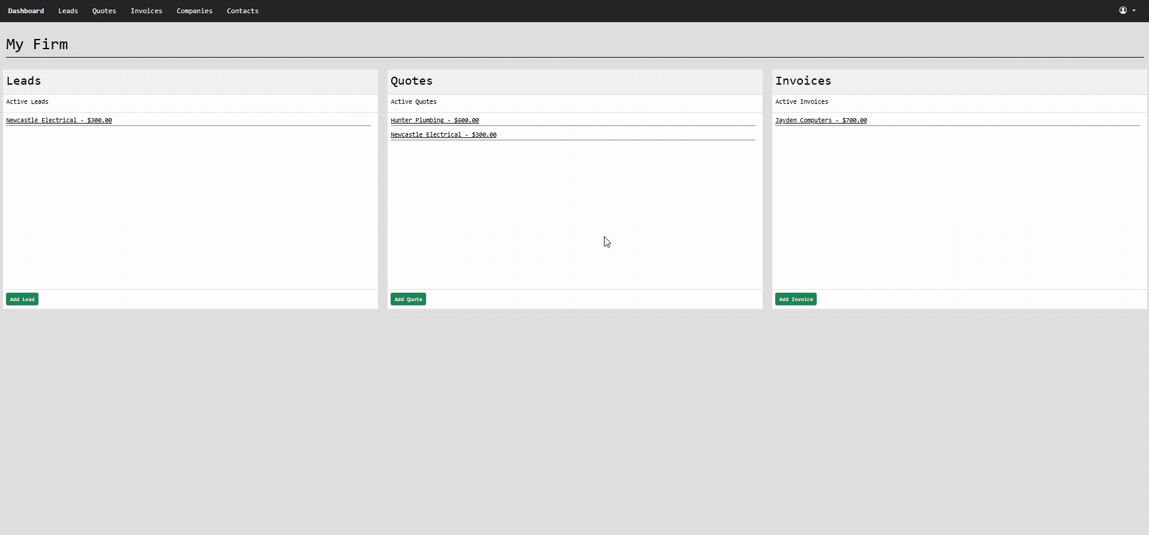
Quotes
Notes:
Quotes
Quotes allow users to create detailed price offers to companies.
A quote is made up of multiple quote items – these are the individual products or services
Each quote item includes a description and a price
The total value of a quote is automatically calculated from the item prices
Quotes are linked to a company to stay organized
Quotes also have the option to be exported into a pdf

Slide 14
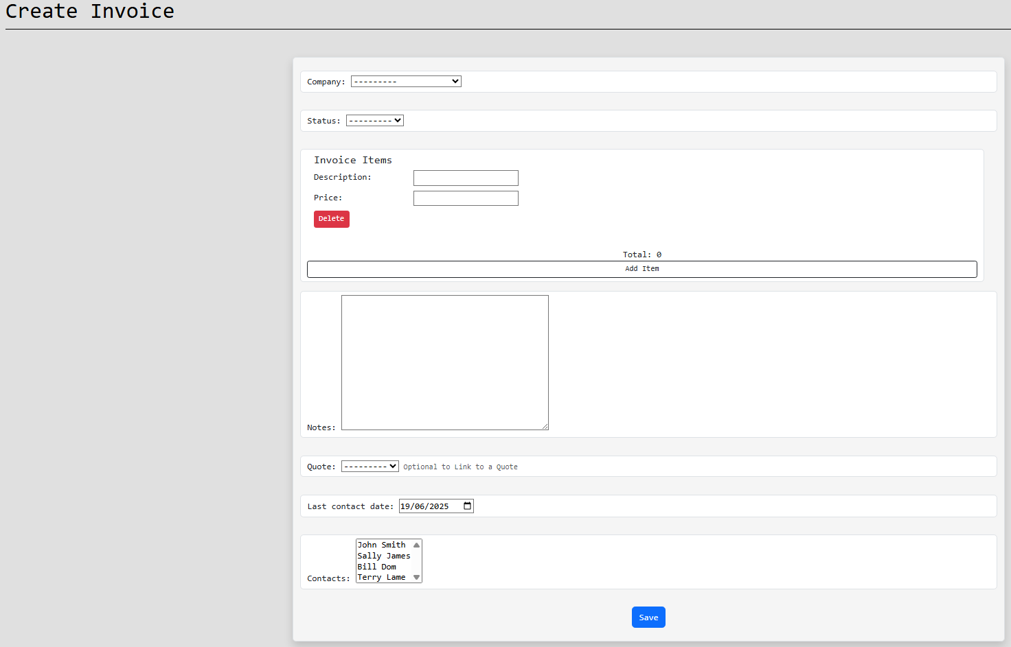
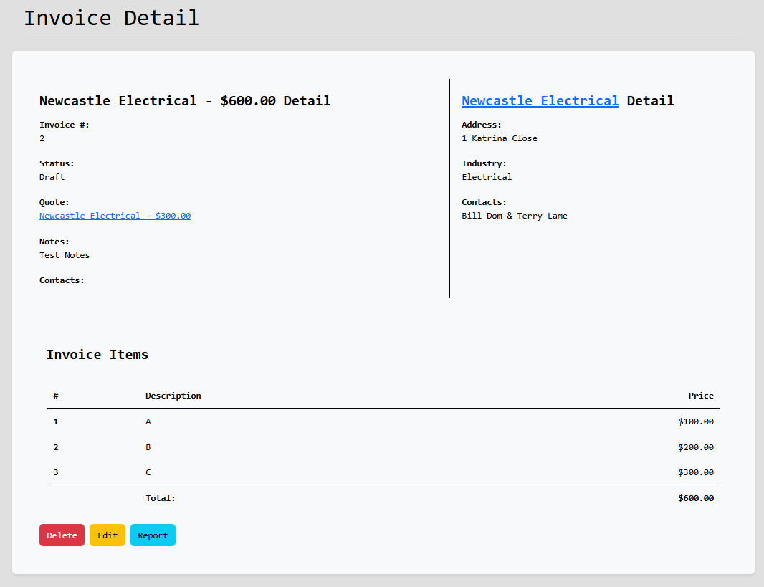
Invoices
Notes:
Invoices
Invoices allow users to create detailed price offers to companies.
An invoice is made up of multiple invoice items – these are the individual products or services
Each invoice item includes a description and a price
The total value of an invoice is automatically calculated from the item prices
Invoices are linked to a company and also can be linked to a quote to stay organized
Both invoice and quote are very similar, and I ended up using the same structure to create both of them
Invoices also have the option to be exported into a pdf

Slide 15
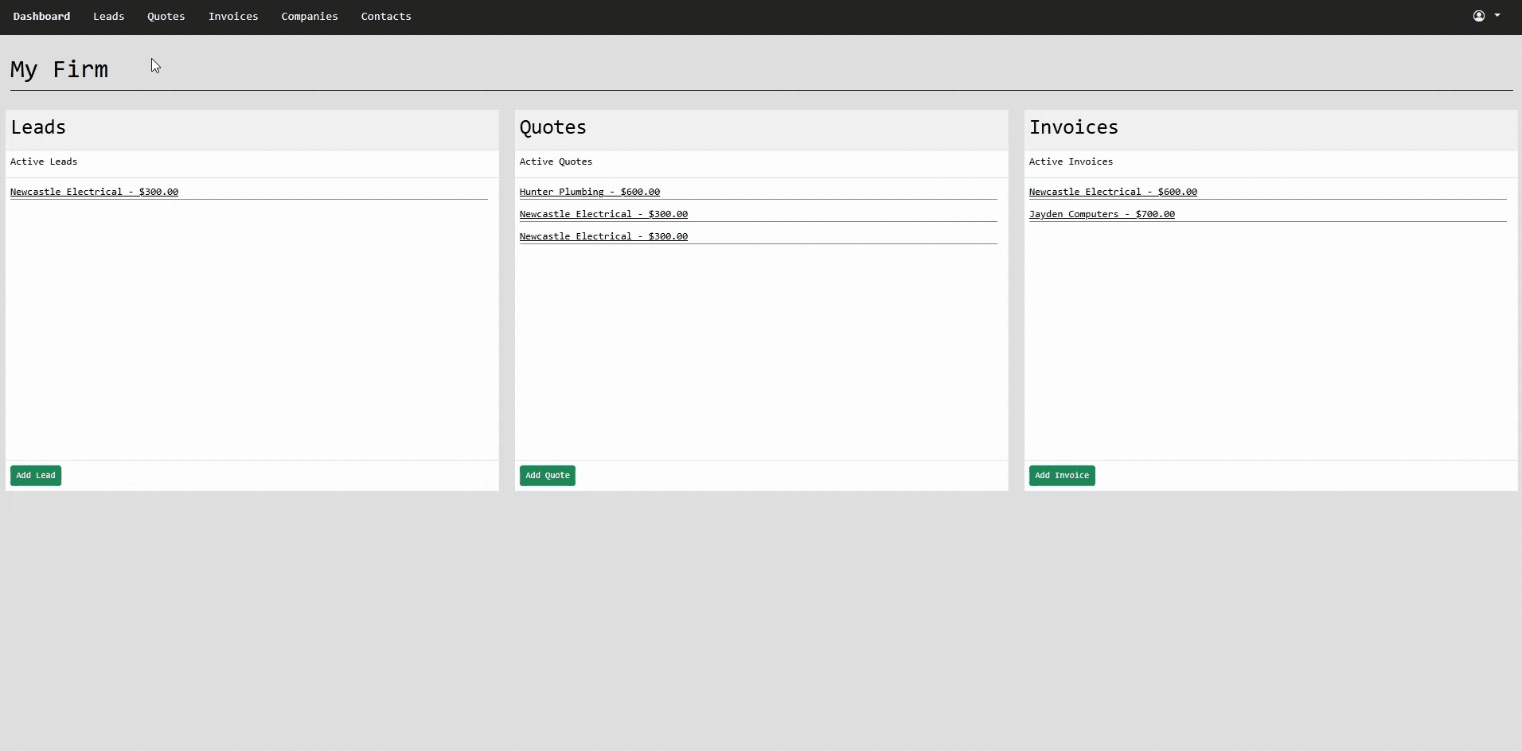
Firm’s Leads/Quotes/Invoices/Companies/Contacts
Notes:
Firms Views
These links in the navigation bar show all the corresponding items in the firm
This allows easy access to any item you need

Slide 16
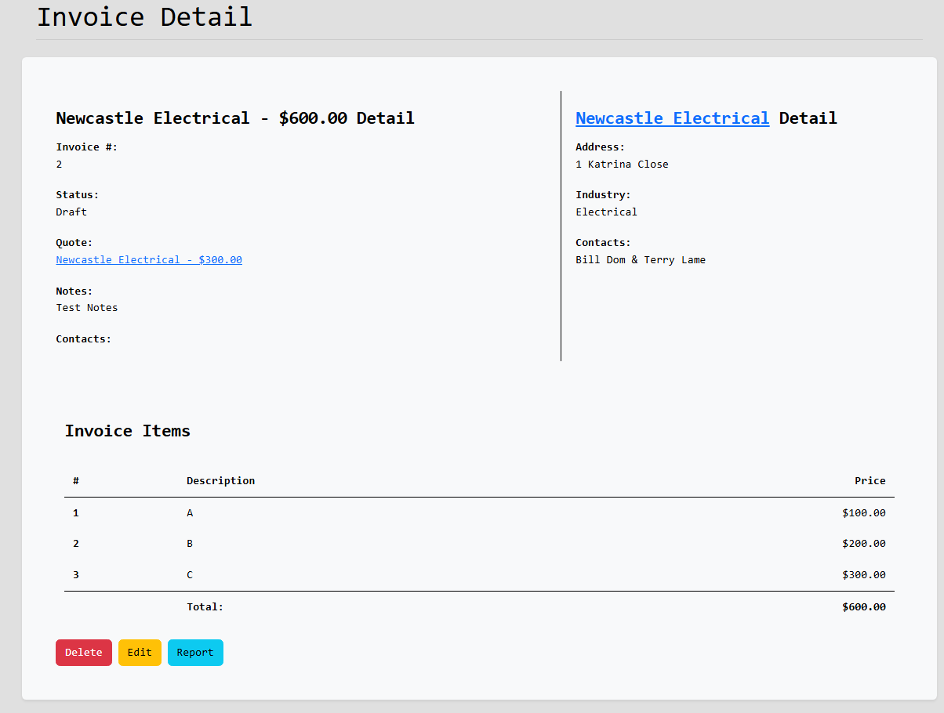
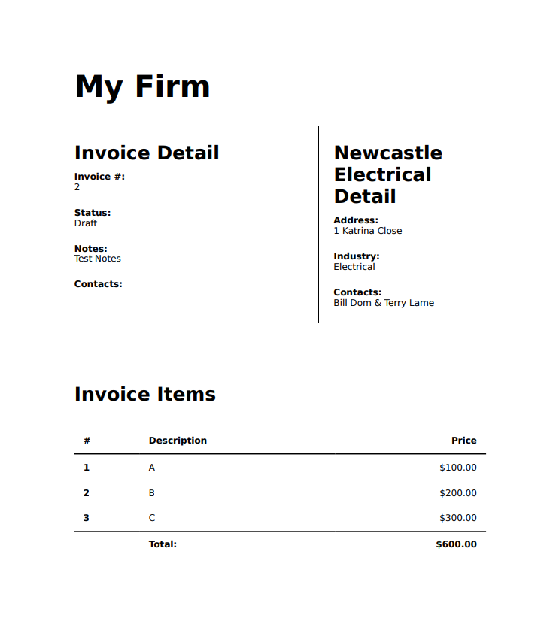
Reporting
Notes:
Reporting
On the left is an Invoice in the CRM and on the right is a PDF on that invoice
The CRM includes a reporting feature to track there quotes and invoice through PDFs
I designed the reports to be clear and visual
Reporting will make it easier to share reports with managers or clients

Slide 17
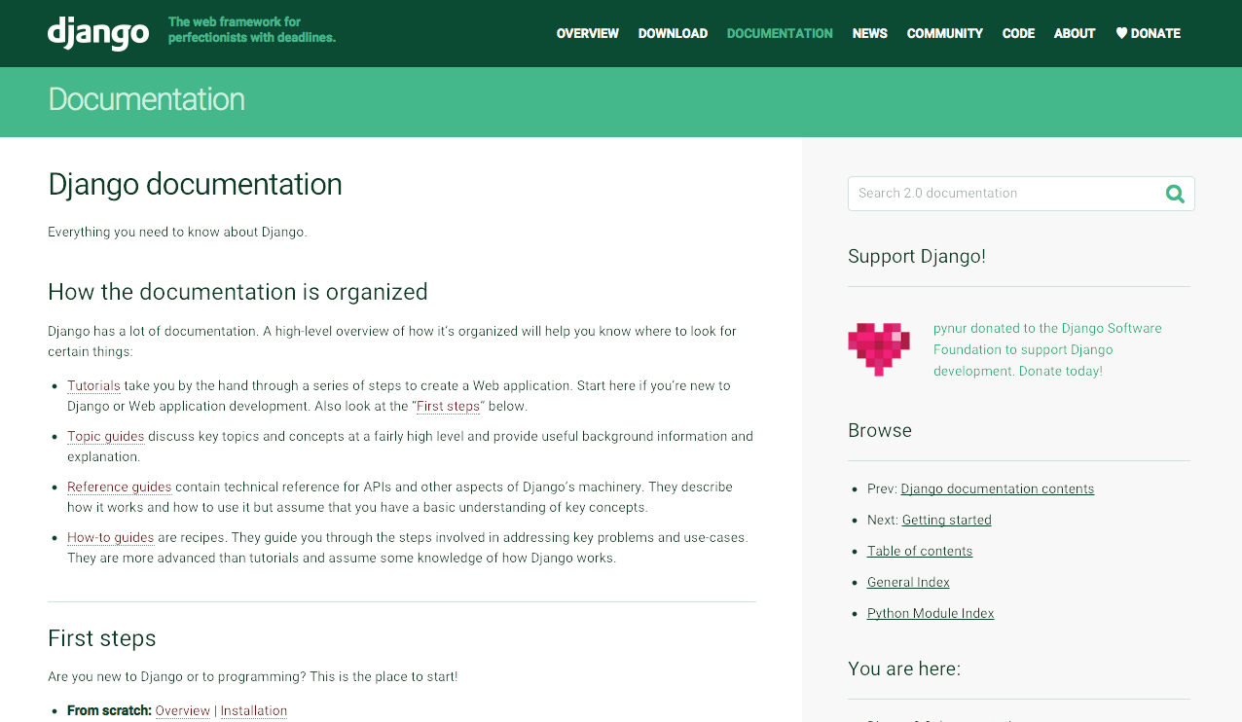
How did I make the App?
Notes:
How did I make the App?
Django, which is a powerful web framework for Python
Quickly set up the core functionality of the app
Features:
Admin panel
Authentication system
URL routing
Security
Started by designing Models – SQL Tables
Views to handle user interactions and connect them with the models
HTML templates and used Bootstrap
Implemented permissions and user roles
Forms and Formsets to create and edit data

Slide 18
Django Models
Notes:
Django Models
Django models define the structure of your database using Python classes.
Each model maps to a database table automatically.
Django’s ORM (Object-Relational Mapper) lets you interact with the database using Python instead of SQL.
Models are reusable, secure, and easy to update
Custom methods inside models can be added for extra logic like calculating totals or formatting a string
An example of a model would be this **Show Model**

Slide 19
Django Model Forms
Notes:
Django Model Forms
Django Model Forms automatically create forms based on your models.
They save time by generating input fields that match the model fields.
Validation and saving data to the database is handled automatically
Easily customize the layout, labels, widgets, and validation rules
Calling .save() on a form updates or creates a model instance
Helps keep your code clean and removes repeated code
An example of a model form would be this **Show Model Form**

Slide 20
Django Model FormSet
Notes:
Django Model Formset
A Django formset is a group of multiple forms managed together as one
They’re useful when you need to add, edit, or delete multiple items at once like quote items or invoice lines.
They handle form validation, ordering, and deletion for multiple forms at once
This helped me build flexible features like quotes with multiple line items in my CRM
An example of a model formset would be this **Show Model FormSet**

Slide 21
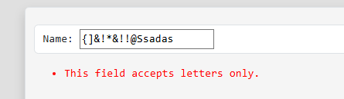
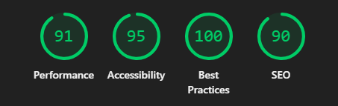
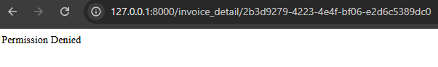
Testing
Notes:
Testing
Manual testing was done across all views and urls to check for bugs or layout issues.
I also performed form validation testing to make sure user input is handled safely and accurately.
I ran Lighthouse audits to check performance, accessibility, best practices, and SEO.
The site received an overall good score which shows it’s well-optimised and fast-loading.

Slide 22
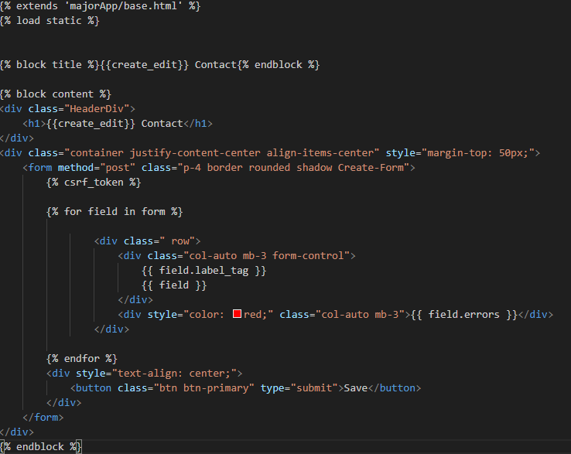
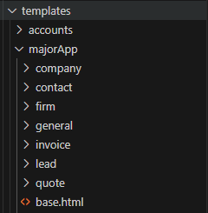
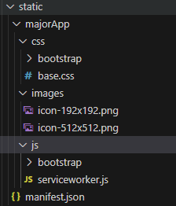
Structure
Notes:
Structure
The app uses a Django backend, which handles business logic, database models, authentication, and form validation.
The frontend is server-rendered using Django templates, styled with Bootstrap for a dynamic and better looking design.
The system is scalable and can be extended with APIs or JavaScript frameworks in the future if needed
The web app is a PWA so features like a manifest.json file that defines the app icon and name are included while also be accessible for apple users.

Slide 23
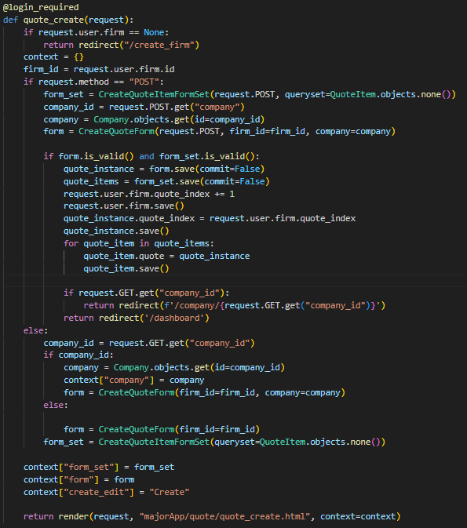
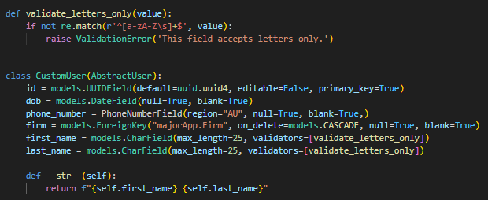
Code
Notes:
Code
The code is written using Django best practices, making it easy to understand, maintain, and extend over time.
I used clear naming conventions for models, forms, views, and templates, for example, models like Lead, Quote, and Invoice are understandable by just the name
Fields in the models or variables follow the python standard naming conventions with underscores joining words and being all lowercase.
The app uses standard Python data structures like dictionaries, tuples and lists making it easy for other developers to work with.

Slide 24

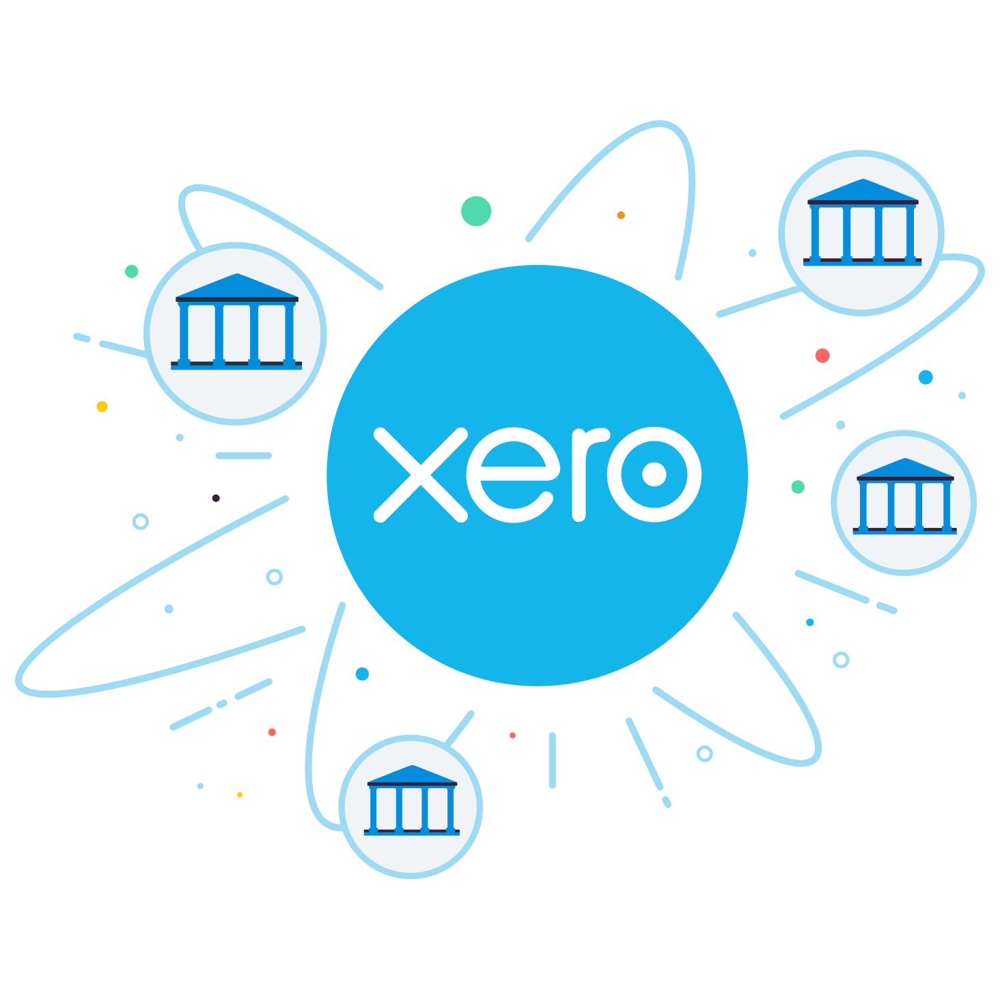

Reflection on the Tools
Notes:
Reflection on the Tools
Django was a great fit for the project considering how easy, simple and fast it is to develop a web app.
For production I would switch to PostgreSQL consider it handles queries better and works well with Django
Django’s scalability and modularity make it a good long-term choice, allowing me to add more features without any hassling
I would have built an API connection with Xero so the user's invoices can be uploaded to it but with the time the client gave me to complete the project it wasn’t feasible.
Using react for the front end could work well and make a more dynamic and cleaner look to the website.
Overall, the tools I chose were appropriate for the scope of the project, but I can see other tools becoming more useful as the project grows.

Slide 25
What I would do differently next time
Notes:
What I would do differently next time
First thing would be writing unit tests for every view to automate the testing phase
I would improve my lighthouse score by making the templates load quicker and sql queries faster and more efficient.
Testing on mobile devices is another thing I would do more often considering how many people have phones.
I would also focus more on the design from the start instead of doing it last minute.
I would start documentation, and comments from the start to not only help me but other reading the code

